Slide 1
EMPLOYEE MANAGEMENT SYSTEM
Murali Krishna
Codinghub.CO.in

Slide 2
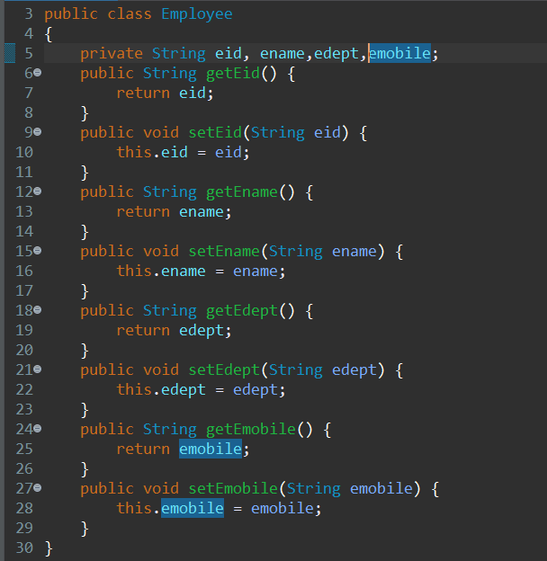
DTO

Slide 3
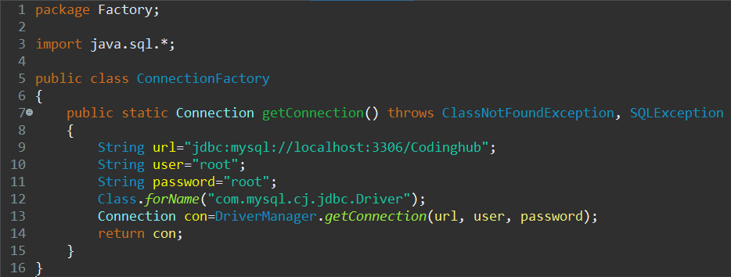
CONNECTION FACTORY

Slide 4

DAO

Slide 5
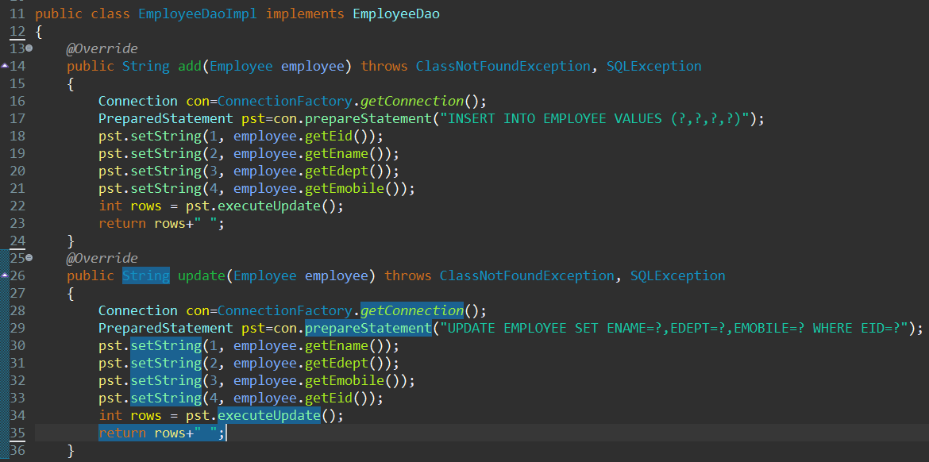
DAOIMPL

Slide 6
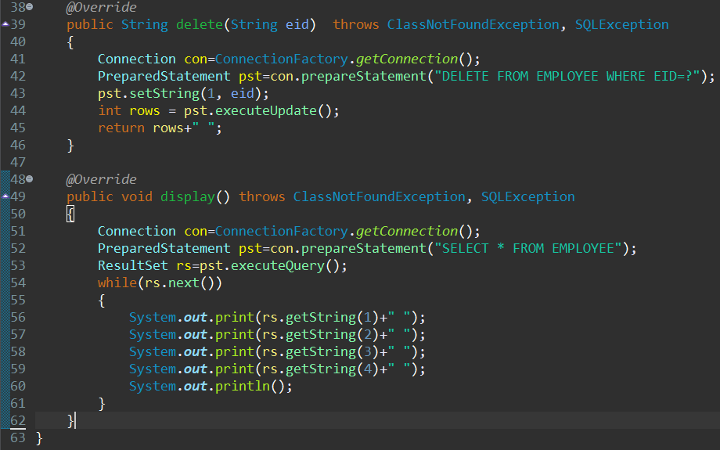
DAOIMPL

Slide 7
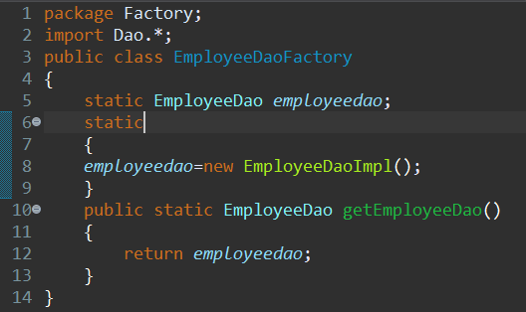
DAO FACTORY

Slide 8

SERVICE

Slide 9
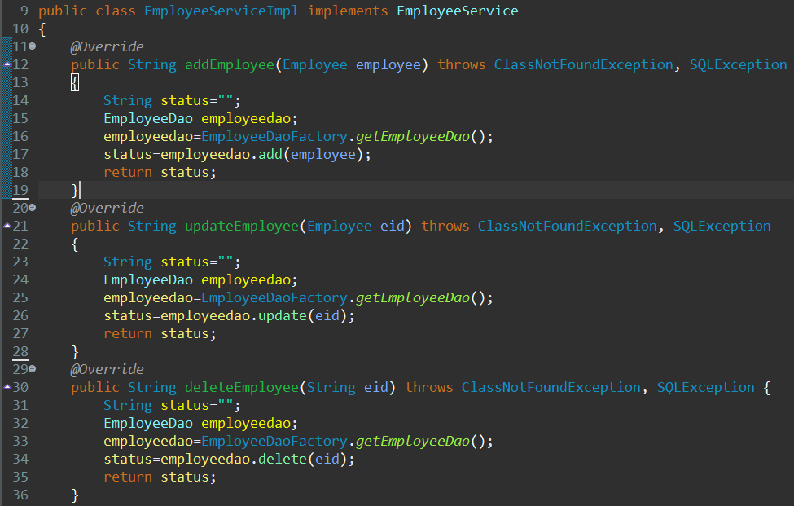


Slide 10
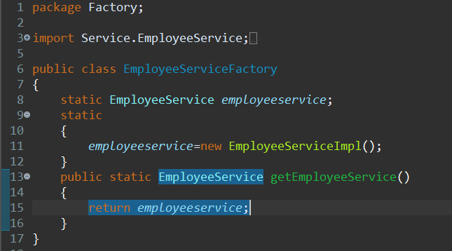
SERVICE FACTORY

Slide 11
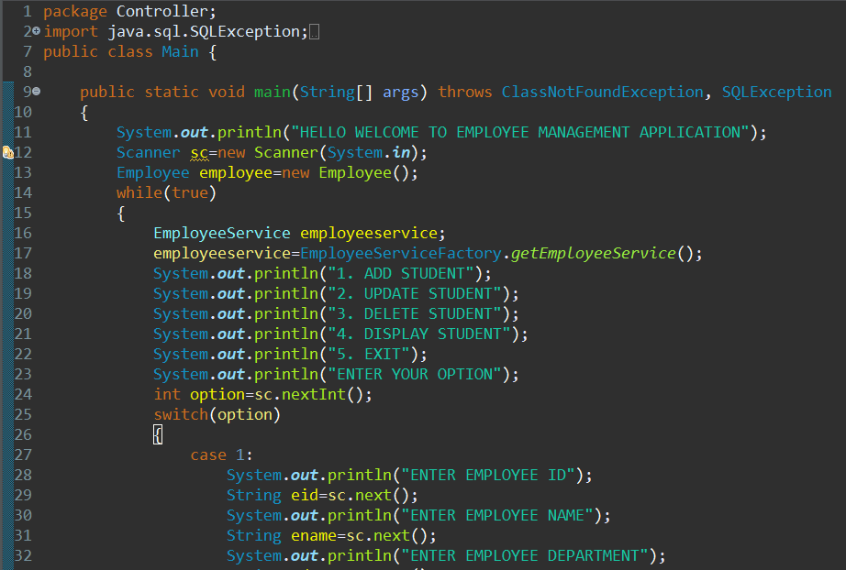

Slide 12
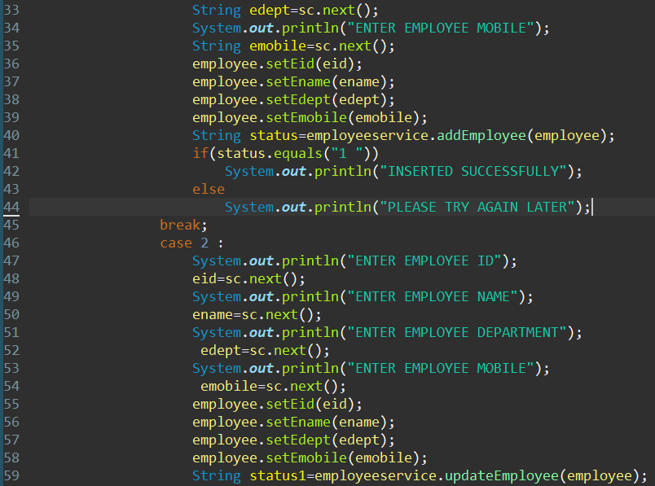

Slide 13
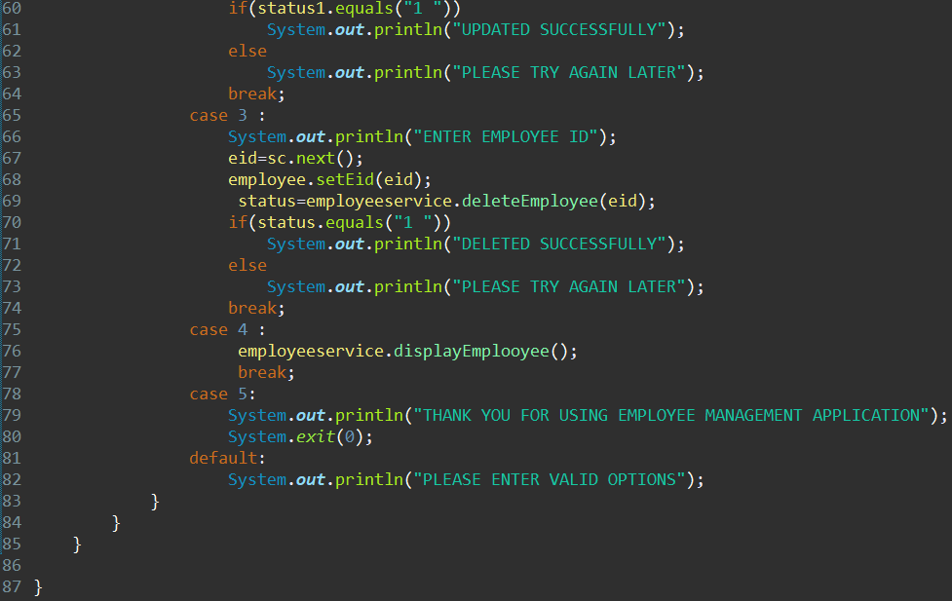

Slide 14
Thank You

